Slide 1

Introduction to Machine Learning Final Project Fall 2020 Sentiment Analysis
By:
Kiki Sarpong (kys254)
Sakshi Mishra (sm9268)

Slide 2
OBJECTIVE
Our objective is to identify the emotions of the author of any textual data using various machine learning models such as Logistic Regression, Naïve Bayes Model and RNNs.
Emotions are classified as highly positive, somewhat positive, neutral, somewhat negative and highly negative.
We chose to perform text recognition on the dataset available at https://www.kaggle.com/snap/amazon-fine-food-reviews. This “Amazon Food Review” file represents food reviews of 1000+ users and the score each user gave to a particular product.

Slide 3
MOTIVATION
Manufacturing and marketing organizations need to analyze the consumer response to stabilize their product in the market.
Online product reviews are the most easily available sources of consumer response on the internet.
Manipulation of such reviews can help businesses realize the satisfaction of the consumers with respect to their products and hence such businesses can establish an equilibrium between the quality of product they supply and the expectations of the consumers.
This is where sentiment analysis can play its role. With sentiment analysis of millions of reviews available on the net any organization or person can analyze and predict the performance of their product.
This in turn can help such organization to improve their profits.

Slide 4
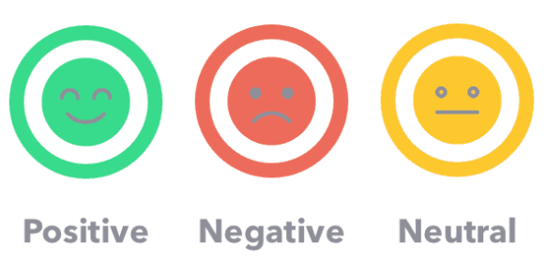
SENTIMENT ANALYSIS
By the use of Natural Language Processing, any textual data can be quantified so as to categorize the overall sentiment of the text as positive, negative or neutral.
Techniques namely Tokenizing, Stemming Lemmatizing and Vectorization are implemented on the dataset to preprocess the data. These techniques make analysis of the data less complicated.

Slide 5
TOKENISATION
The words and punctuations in a sentence are separated as single items or “tokens”. For instance, a sentence
“Hey, welcome to New York University!”
after tokenization will get transformed to
'Hey', ‘,’ ,'welcome', 'to', 'New', 'York', 'University', ‘!'
STEMMING
The words in text are reduced to its root form using stemming algorithms. Generally, it truncates the suffix or prefix of the word to reach to its root word. For example, words like
“likes”, “liked”, “likely”, “liking”
after stemming will get transformed to the word
“like”

Slide 6
LEMMATIZING
Similar to stemming lemmatizing process also converts word into its root word. Uses WordNet corpus to go to word root. However the results of the stemmed words may or may not be a proper word, but results of lemmatized words are always proper words in their respective language. For example, words like
“rocks”, “corpora”, “better”
after lemmatizing will get transformed to the word
“rock”, “corpus”, “good”
respectively.
VECTORIZATION
A series of words in a text can not be easily analysed by a machine. Thus these words are converted into a numerical value for analysis and stored as vector of those words. This process is called vectorization.
TFIDF and Count Vectorizer methods are further used in this code to extract the words of reviews as features such that the numerical value associated them can build a relationship between the reviews and the sentiment.

Slide 7
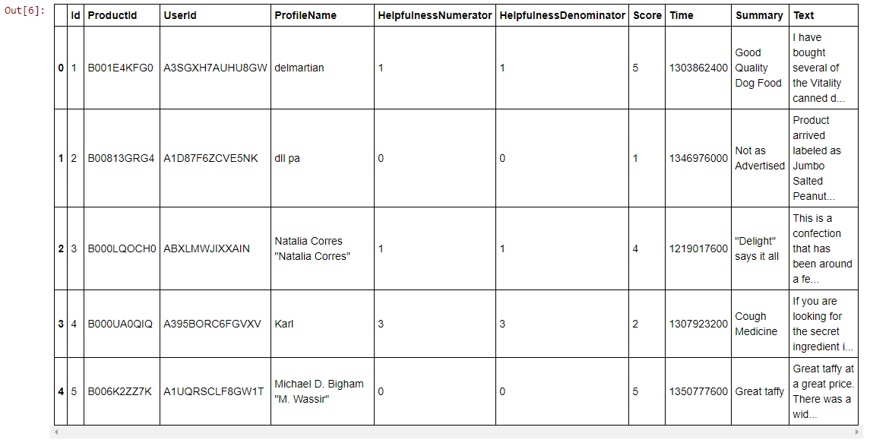
DATASET
Following columns are present in the dataset.
Id | ProductId | UserId | ProfileName | Helpfulness Numerator | Helpfulness Denominator | Score | Time | Summary | Text
The unique identification number given to each row. | The unique identification number given to all products. | The username of the author of the review. | The actual name the user uses on the amazon platform. | The count of users who acknowledged the review helpful. | The total count of users who acknowledged the review helpful or not helpful. | The score given by author to a particular product. Range from 1-5, where 1 is the least. | The time at which the review was uploaded on the platform. | Concise representation of the review. | Actual review.

Slide 8
CODE EXPLANATION

Slide 9

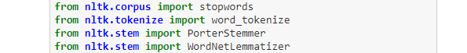
LIBRARIES
At the beginning of the code, following libraries were imported for data manipulation.
The regular expression library ‘re’ is used to eliminate noise from the data.
NLTK package is ‘Natural Language Toolkit’ which is used to preprocess the review texts.
From this package we import stopwords to eliminate stop words such as “a”, “an”, “the”, etc. to reduce number of words in dataset.
To perform Tokenising, Stemming and Lemmatizing we import word_tokenize, PorterStemmer and WordNetLemmatizer.

Slide 10
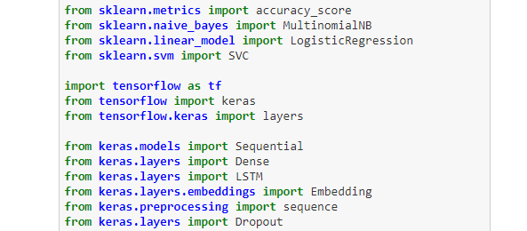
For Vectorization we use the TfidfVectorizer module.
To split the data in train and test we import train_test_split.
Following libraries are imported for the sake of the models that we’ll be using in this project.

Slide 11
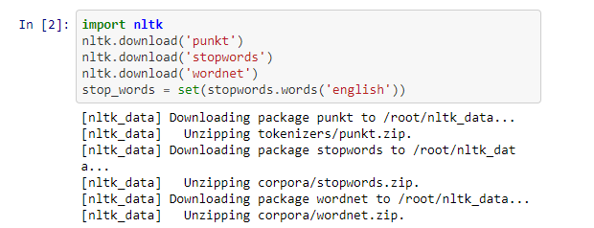
STOP WORDS
To store all the desirable stop words:
Import and download the whole range of stop words available in the nltk package.
Create a set of stop words in the English language and store it the variable ‘stop_words’.

Slide 12

FUNCTIONS
To remove these columns that to do not contribute in the analysis of data, delete_redundant_cols function is made. The dataframe and column names of that dataframe are passed as parameters into this function. This function shall return a new dataframe which does not contain the columns passed in this function as a parameter.

Slide 13
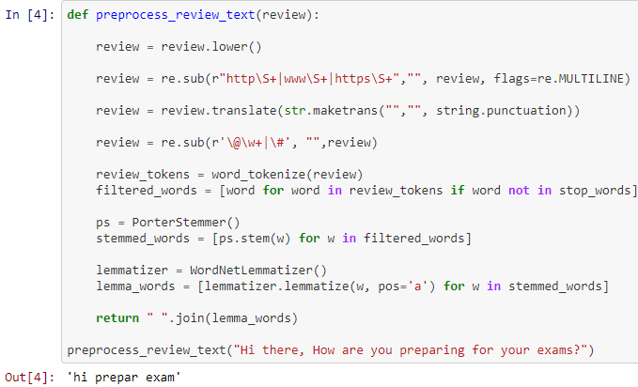
FUNCTIONS
This function is for preprocessing the text under the column name ‘Text’ in our dataset.

Slide 14
Convert the text into lower case.
FUNCTIONS
This removes any URLs in the text. "http\S+|www\S+|https\S+“ signifies command to removal of ‘http’, ‘https’ and ‘www’ links and replace it with “ “. Flags are set to MULTILINE to instruct the python to match special characters to match the start or end of any line with a string.
This line of code removes all punctuation marks represented by ‘string.punctuation’ and replaces them with “ “.
This line of code removes all usernames and hashtags and replaces them with “ “.

Slide 15
Tokenise the text and then save those words or “tokens” in a list such that those words are not stopwords list. Here we get rid of the stopwords.
FUNCTIONS
Use PorterStemmer method to find all the stemmed words and save it a list.
Convert all stemmed words into lemmas and store it in the list lemma_words.

Slide 16

FUNCTIONS
The following ‘get_feature_vector’ function is defined to produce the vector of words present in the review text. We made an TfidfVectorizer object named ‘vector’ and fit our review into this object.
This function return the vector with numerical values.

Slide 17
LOADING THE DATASET
The dataset is in csv format. It the stored in a dataframe named ‘df’, and the encoding is ‘latin-1’.

Slide 18
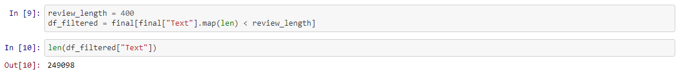
DUPLICATE DATA
This cell checks all duplicate entries in the dataframe and drops those duplicate entries.
LIMIT CHARACTER SIZE
For the sake of smaller dataset we select and save only those entries whose character size of review text is less than 400 characters.

Slide 19
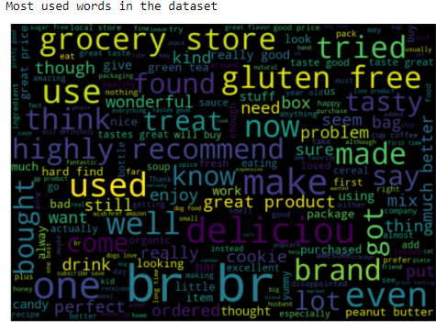
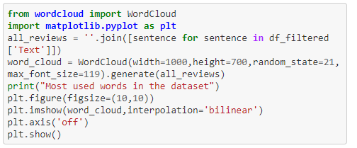
GRAPH OF FREQUENT WORDS
The wordcloud package is imported in this cell for visual representation of frequently occurring words in the text column of the dataset. Matplotlib.pyplot is imported to plot the word cloud.
The reviews are combined together and stored in the variable ‘all_reviews’. Then it is passed in WordCloud function to generate the plot.
In this plot the frequency of these words can be determined by the font size of each word. Bigger the font, more frequent the word is in the reviews.

Slide 20
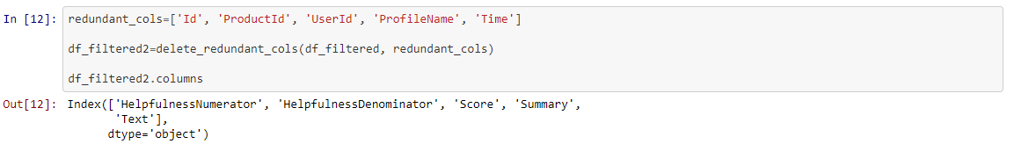
DELETE UNWANTED COLUMNS
Since columns Id, ProductId, UserId, ProfileName and Time do not contribute towards the product reviews of the user, we dropped these columns from the dataframe. The filtered dataset now consists of remaining columns: ‘HelpfulnessNumerator’, ‘HelpfulnessDenominator’, ‘Score’, ‘Summary’ and ‘Text’.

Slide 21

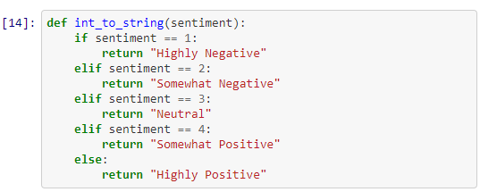
SCORE
To find the range of scores this code is used. We can see that the score ranges from 1-5.
For the ease of the user we defined the sentiment associated with each score in this function. Since 1 is the least score as it is a highly negative review, 2 is somewhat negative, 3 is a neutral review, 4 is somewhat positive review and 5 is a highly positive review.

Slide 22
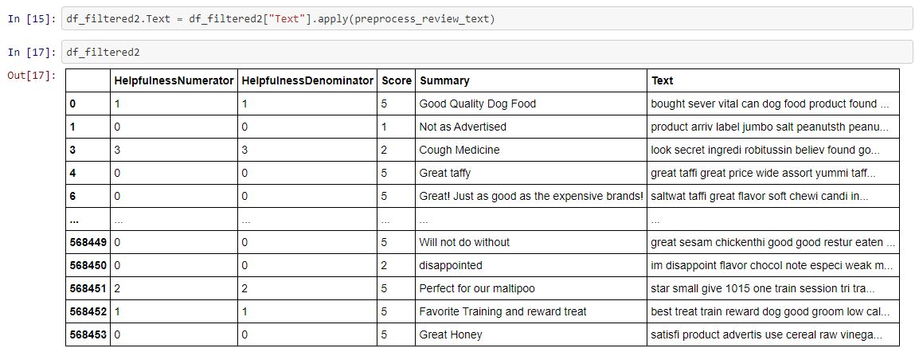
PREPROCESSING THE REVIEWS
Using the preprocess_review_text function defined previously, we obtained processed text for reviews as it can be seen below in the text column of the dataset. Words are reduced to their root form and stored in the text column.

Slide 23
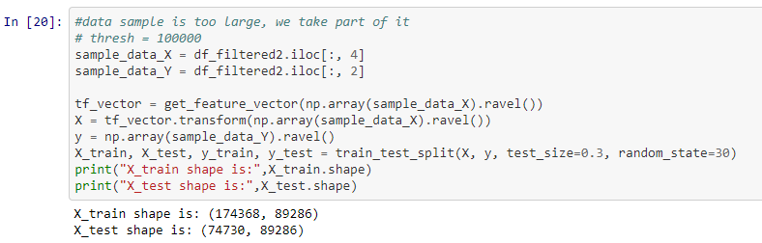
FEATURE EXTRACTION
The review text is the feature on which models are supposed to train on. We store the column ‘Text’ which contains the review text in ‘sample_data_X’. The target is the score associated with each review. We select the ‘Score’ column as target and store it ‘sample_data_Y’.
To get the features i.e. the vector of words we pass sample_data_X in the function get_feature_vector. The variable ‘tf_vector’ stores the result of vectorization of review text.

Slide 24
DATA SPLIT
The data stored in the tf_vector is transformed and stored in variable X in form of and array. Similarly, target value ‘sample_data_y’ is also stored in variable y in form of an array.
Using the train_test_split the data is split into train and text data and stored in variables X_train, X_test, y_train and y_train. Since test_size= 0.3, 30% of the data is used a test data and using random_state=30 we can reproduce the similar test data, if needed.
Thus, 174368 rows are present in the training data and 74730 rows are present in the test data.

Slide 25
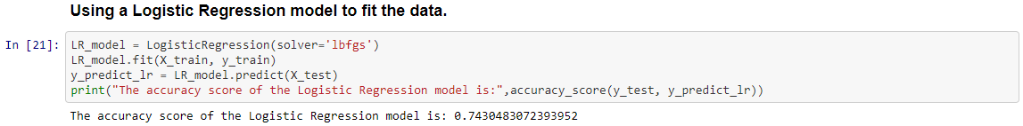
LOGISTIC REGRESSION MODEL
Since the target can be categorized to individual scores which are 1,2,3,4 and 5, we can apply the Logistic Regression Model for this dataset.
We create a Logistic Regression object ‘LR_model’ and then fit our training data into that model.
Then we use the testing data ‘X_test’ to predict what scores would this model predict for the reviews and then compare the predicted scores with the actual score to find the accuracy of the model.
The accuracy of Logistic Regression model ranged from 74% to 76%.

Slide 26
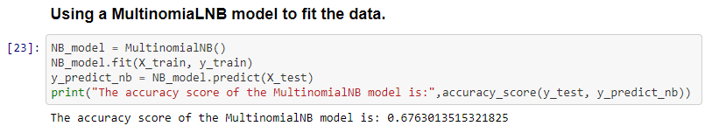
NAÏVE BAYES MODEL
The Naïve Bayes model uses conditional probability to predict the categories. The category with the highest conditional probability is assigned as the predicted values.
We create a naïve bayes model object ‘NB_model’ and then fit our training data into that model.
Then we use the testing data ‘X_test’ to predict scores and store them in the variable ‘y_predict_nb’ and then compare the predicted scores with the actual score to find the accuracy of the model.
The accuracy of the Naïve Bayes model ranged from 67% to 70%.

Slide 27
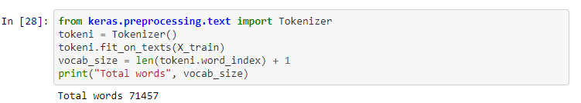
PREPROCESSING THE DATA
Another way to tokenise the words in the reviews can be implemented using keras. We made an tokenizer object ‘tokeni’ and fit our training data to obtain the words and individual tokens.

Slide 28
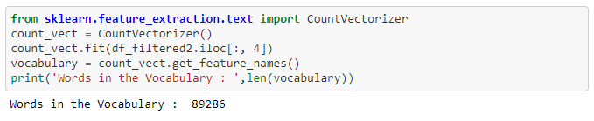
FEATURE EXTRACTION
In the previous function we used the tfidf vectorizer. Another method to vectorise text into numbers can be seen in this code.
The difference between tfidf and count vectorizer is not much. They both are used for vectorization however, CountVectorizer returns integer values associated with the words, whereas tfidf returns floats values.
An CountVectorizer object ‘count_vect” is created and the text reviews are fitted into the object. To store the vectorised data, variable ‘vocabulary’ is used. We can see that there are 89286 distinct features in the vocabulary.

Slide 29
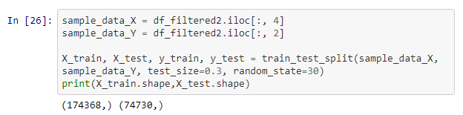
DATA SPLIT
Using the train_test_split the data is split into train and text data and stored in variables X_train, X_test, y_train and y_train. Since test_size= 0.3, 30% of the data is used a test data and using random_state=30 we can reproduce the similar test data, if needed.

Slide 30
PADDING
For the data to be fed in an RNN model, all input data should of the same length. Thus we introduce padding in our data.
The variable max_review_length is set to 100. Using this variable as a threshold padding of X_train and X_test data is done. In this, if the length of a review is greater then hundred then is it truncated and if the length is less than hundred then null values are padded at the end of the review. Thus all review data will now have the same length.

Slide 31
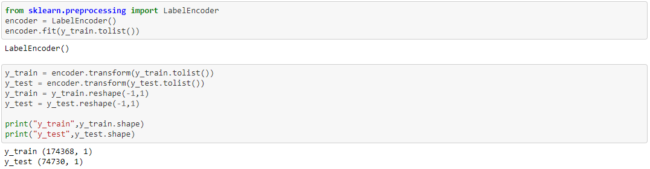
ENCODING
Label Encoder is used here to encode the target value which is the score into values that range from 0 to number of classes(i.e. 5) -1. This is done so that the RNN can process the target values.

Slide 32
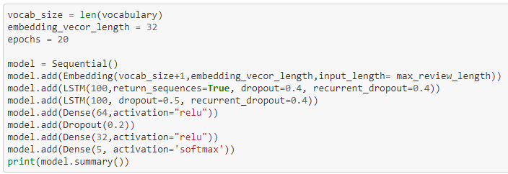
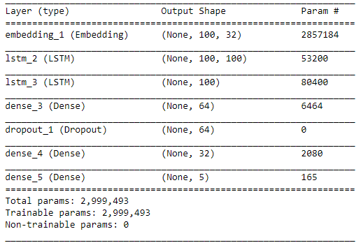
RNN MODEL
We developed a RNN model with some layers imported from Keras. We built a model which has 1 embedding, 2 LSTM, 3 Dense and 1 dropout layers.
This represents the summary of our model. As mentioned we have 2,999,493 parameters in total that need to be trained on our review dataset.

Slide 33
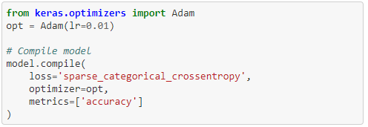
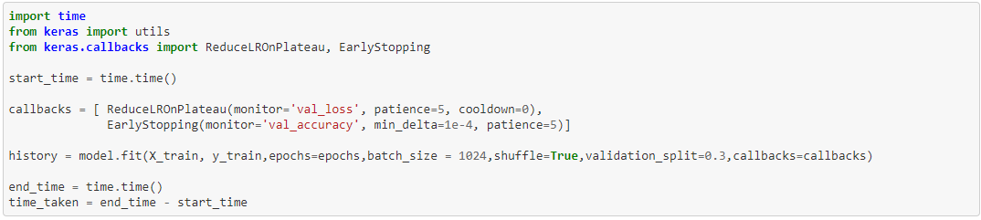
RNN MODEL
Adam optimizer is selected and then the model is compiled. Sparse categorical cross entropy loss function is used since the target is in categories of score from 1-5. To measure the accuracy of the model we set the metrics as ‘accuracy’.
We import and use the time module to measure how much time our model takes to fit the data. Using model.fit we train our model using 20 epochs and batch size is set as 1024. We chose to store the results of each epoch in a dictionary named history.

Slide 34
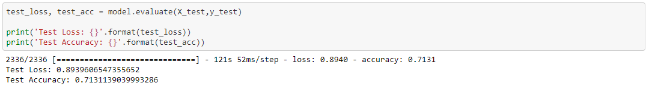
ACCURACY OF RNN MODEL
The test loss of the model came out be around 80% and the accuracy of our model ranged from 71% to 75%. Since the training of model was done only on a small sample of data due to the restriction of computational power of our computers we assume that is why the accuracy stunted at 75%. If the whole data is trained on the model the accuracy can significantly improve.

Slide 35
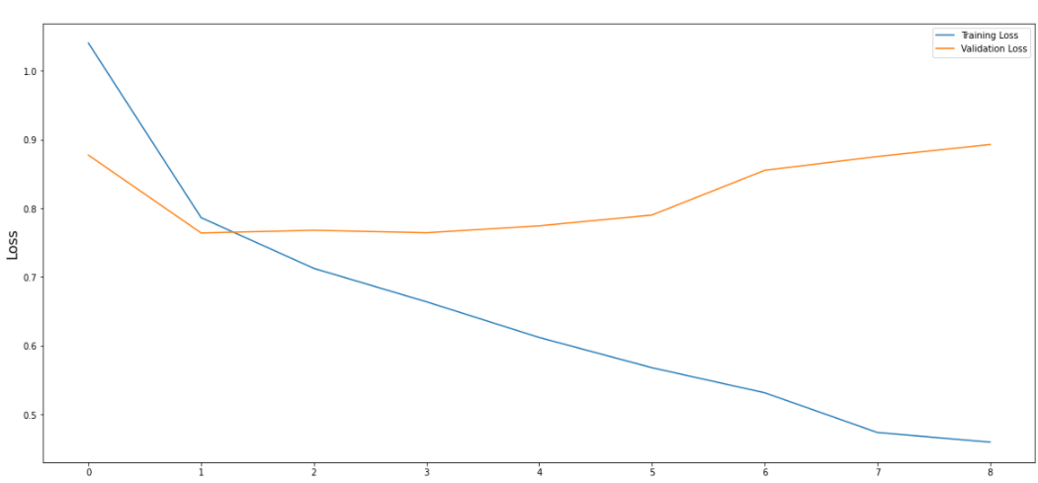
VISUALISING THE LOSS
With each epoch we plotted the training loss and validation loss and got the following result
With each epoch the validation loss increases, however the training loss decreases.

Slide 36
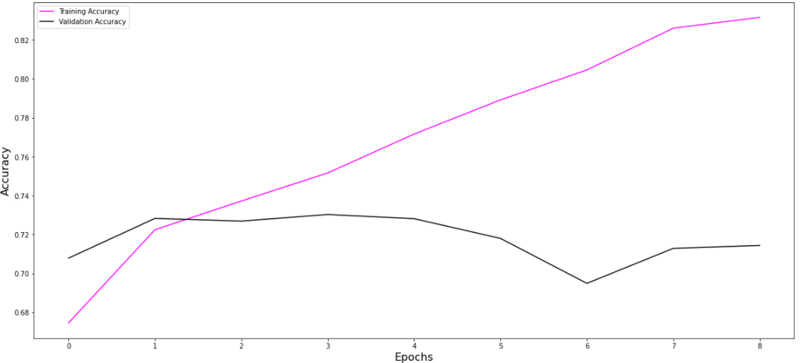
VISUALISING THE ACCURACY
With each epoch we plotted the training accuracy and validation accuracy, and got the following result
With each epoch the training accuracy of our model increases.

Slide 37
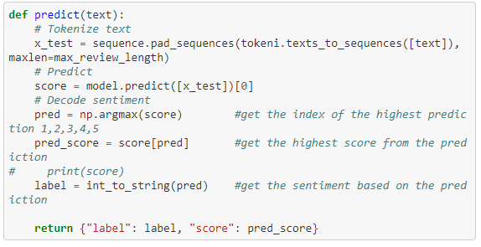
PREDICTION FUNCTION
To manually test our model we built a predict function
This function takes a text review and then tokenizes it first.
We fit the tokenized data the RNN model and store the predicted score.
Then using the int_to_string function defined before we display the associated sentiment with the score.

Slide 38
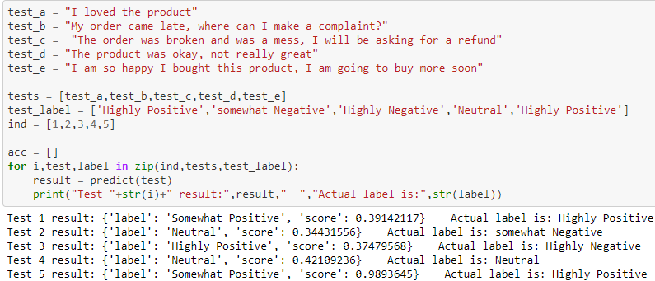
PREDICTION FUNCTION
We passed the following dummy data into the function. And got the following results.
To summarise, our RNN model is able to predict the sentiment almost nearby the actual sentiment of the text.

Slide 39
CONCLUSION
We performed sentiment analysis on a dataset of product reviews and tried to predict the sentiment of the text using Logistic Regression, Naïve Bayes and RNN model.
The least accurate model was the Naïve Bayes model, RNN model offered an accuracy of around 70-75% and the Logistic Regression model had the highest accuracy of around 74-76%.
The scope of the RNN is that if RNN model is trained on the whole dataset with better hardware the accuracy of the RNN can reach upto 90%.

Slide 40
REFERENCES
https://www.pluralsight.com/guides/building-a-twitter-sentiment-analysis-in-python
https://www.kaggle.com/muhammadrehan444/advance-sentiment-analysis
https://github.com/PankajKarki/Amazon-Food-Reviews-Analysis-and-Modelling/blob/master/LSTM_Amazonfinefoodreviews.pdf
https://github.com/yanndupis/RNN-Amazon-Fine-Food-Reviews/blob/master/Amazon%20Fine%20Food%20Reviews.ipynb
https://github.com/yanndupis/RNN-Amazon-Fine-Food-Reviews/blob/master/Report/Fine_Food_Review_Sentiment_Analysis_Report.md

